Slide 1

SMART INDIA HACKATHON 2024
TITLE PAGE
Problem Statement ID : - SIH1605
Problem Statement Title :- Women Safety Analytics - Protecting Women from Safety Threats
Theme :- AI generated threat detection system
PS Category :- Software
Team ID :- 35
Team Name (Registered on portal)

Slide 2

Guardians Eye : Smart Surveillance Solutions
Detailed Explaination of the proposed solution :- In our approach, we have used different Deep learning, computer vision algorithms and models such as YOLO, MediaPipe, Transformers to detect various traits of a potential threats to a women such as detection of hotspot location based on past events, classification and getting ratio of people’s gender around the victim, detection of emotion and gesture of the suspect. Using all these traits, an alert will be generated if there is a possibility of such incidents.
How it addresses the problem:- Here the generated alert
will be sent to the nearest police station / surveillance system
which will be able to send help in such situations.
Innovation and Uniqueness of the solution :- Our solution consists
of AI powered analytics, real time object tracking, facial recognition
and identification, multi sensor fusion, and uniqueness of the solution
lies that the suspect need not to do anything to get the help and such incidents
can be stopped from taking place.

Slide 3
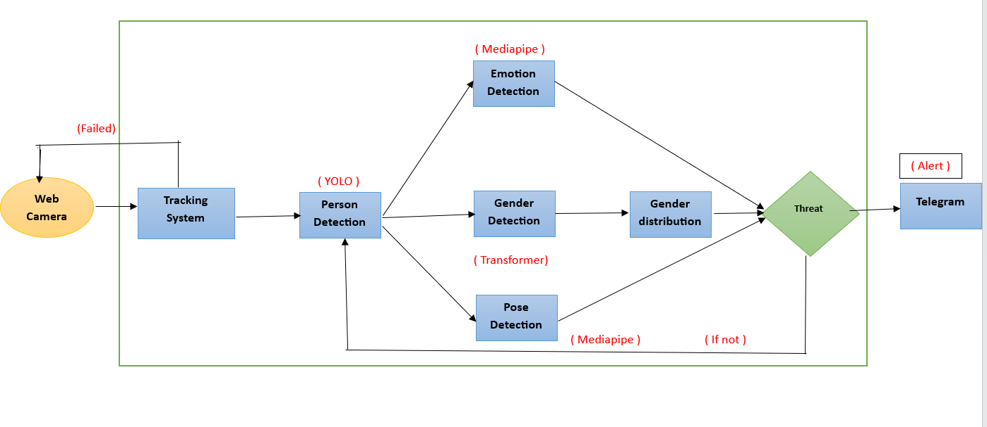
TECHNICAL APPROACH
Technologies used : Tools:- Power Bi
Languages:- Python
Framework/Libraries:- Pandas, NumPy, Keras, Transformers, opencv, pytorch, Telebot,
Methodology and Process of Implementation:-

Slide 4
FEASIBILITY AND VIABILITY
Analysis of the idea :-
By monitoring Pose, Emotions of individuals, model can detect emotions like anger, distress or hostility leading to harmful actions such as sudden reaching, pushing, grabbing etc. All these things will be helpful in crowded areas where physical space may not allow clear detection using gender classification and ratio of gender in surrounding.
Feasibility:-
The accuracy of these methods can be affected by various conditions such as lighting conditions, angle of the camera, occlusion. similarly emotions of a person in danger can vary widely across cultures and individuals and more such factors. So the model needs to be trained on diverse datasets consisting of all the possible variations to get best possible accuracy.
Challenges and risks:-
Collecting data from public and semi public places can raise significant privacy concerns, since there is a risk that these technologies can be misused for purposes beyond their original intent.
For the system to be effective in real world scenarios, it would need very diverse data, powerful hardware and reliable network infrastructure, also it would be costly to implement which will affect its scalability.
Strategies for overcoming possible challenges:-
By using diverse datasets, techniques such as flipping or rotating images, and incorporating contextual data robustness of model can be increased it will also reduce the chances of false negatives.
Engaging with public group, community groups by hosting public meetings etc will help to build trust among people.

Slide 5
IMPACT AND BENEFITS
Potential Impact on Audience :-
If such systems becomes widespread, it might normalize the idea of constant surveillance, potentially affecting the behaviour of mischievous elements leading in reduction of crime rates against women.
Detection of hotspot for such areas would enable women to take preventive measures such as avoiding certain individuals or areas, thereby potentially reducing the chances of harm.
Benefits of the solution:-
Social :-
Enhanced Safety and Security
Empowerment and better mental health.
Economic :-
Increased Productivity
Lower security and legal costs
Environmental:-
Reduced carbon footprints
Optimized resource allocation
Future Aspects :-
Pretraining the model on more diverse dataset.
Converting the model in a fully functional website.
Extending the model for a functionality of more violence related issues.
Making it functional even on partially informative scenarios.

Slide 6
RESEARCH AND REFERENCES
Links of the reference and research work:-
Research Paper ( Real – Time Flying Object Detection with YOLOv8)
MediaPipe : A framework for building Perceptron Pipelines
Vision Transformer
MediaPipe Hollistic
THANK YOU !

